Slide 1
Weapon Engagement Zone Maximum Launch Range Estimation Using a Deep Neural Network
Joao P. A. Dantas
Andre N. Costa
Diego Geraldo
Marcos R. O. A. Maximo
Takashi Yoneyama
Notes:
I am João Dantas and I will present the work called “Weapon Engagement Zone Maximum Launch Range Estimation Using a Deep Neural Network” developed with the researchers Andre Costa and Diego Geraldo and the with professors Marcos Maximo and Takashi Yoneyama.
This was developed in the context of the project “Aerospace Simulation Environment” from the Institute for Advanced Studies which is a research organization of the Brazilian Air Force.

Slide 2
INTRODUCTION
Simulation environment: level of fidelity
Critical part: modeling missiles
Deciding launching a missile
Weapon Engagement Zone (WEZ)
Notes:
In the context of simulated computational environments, military systems must resemble reality in a level of fidelity that leads to useful conclusions.
When dealing specially with air combat, one of the most critical parts to be modeled is the missile.
One of the most important aspects that a pilot can use to decide whether to launch a missile on an opposing aircraft is the Weapon Engagement Zone (WEZ), which, in simple terms, represents the range of the weapon used in that moment.
The determination of this range is not a simple task since it is influenced by a series of variables from both the shooter and the target.
Moreover, it is naturally dependent on the missile itself.

Slide 3
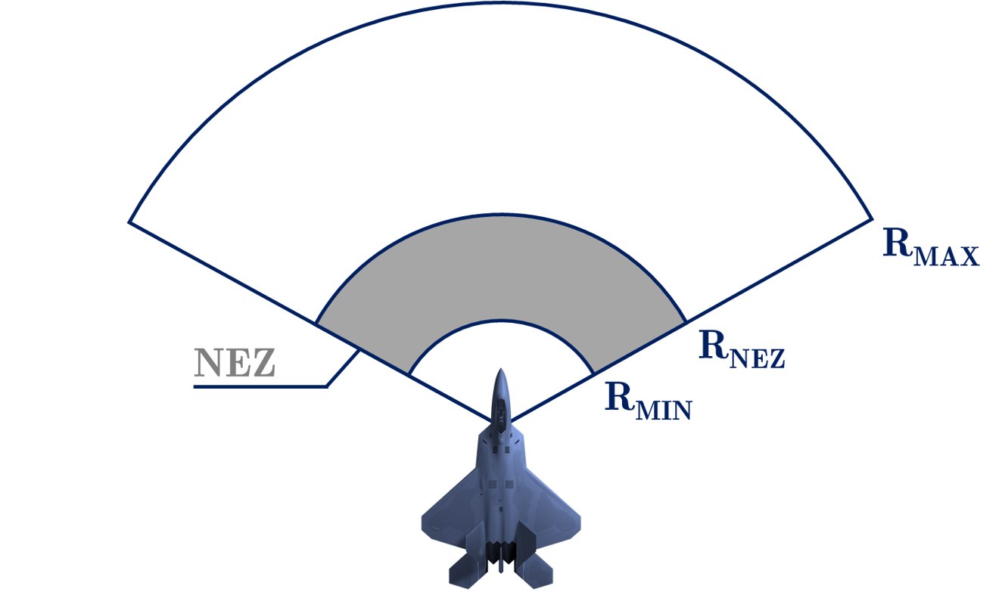
WEAPON ENGAGEMENT ZONE
Notes:
In this simplified representation of a Weapon engagement Zone it is possible to observe the Rmax is defined by us as the maximum distance in which the missile will hit a non-maneuvering target, that is, if the target performs any maneuver, the missile will most likely miss if fired at this distance.
On the other limit of this zone, the Rmin is the minimum distance required by the missile to be able to properly activate its systems and, therefore, trigger its warhead. Between these two ranges, there is the no-escape zone, the Rnez, which represents a distance within which the target is very unlikely to be able to evade the missile, even when employing a high-performance defensive maneuver.

Slide 4
LITERATURE REVIEW
Yoon et al, 2010: Lauch Acceptability Region
Alkaher and Moshaiov, 2015: Dynamic Lauch Zone
Portrey et al, 2005: factors regarding shooter and target
Birkmire, 2011: WEZ determination
Farlik et al, 2017 and Li et al, 2020: mathematical approaches
Notes:
This concept of WEZ can be found in the literature under different terminologies which may present variations on meaning, such as Launch Acceptability Region and Dynamic Launch Zone;
As Portrey state, the WEZ is determined by many factors regarding both the shooter and the target, such as “type of weapon, aircraft speed, relative altitudes, and geometry.” These factors are used to define a metric that allows the pilot to know what is the amount of G-force that must be pulled to escape from an incoming missile. Therefore, their focus was less on the definition of the WEZ per se, but rather on the determination of this particular metric.
On the other hand, Birkmire’s work focuses precisely on the determination of the WEZ for a missile in the context of virtual simulations, which are simulations in which real pilots interact with simulated systems. His goal was to provide the pilots in virtual environments with a similar estimation of the WEZ as pilots in real aircraft have in their heads-up displays (HUDs) to support their decisions to fire a missile.
Previous works have employed some types of Artificial Neural Networks (ANN), such as Wavelet Neural Networks (WNN)~\cite{yoon2010new} and a Multi Layer Perceptron (MLP) with Bayesian Regularization of Artificial Neural Networks (BRANN), to make predictions of the WEZ, also from previously simulated data. Purely mathematical approaches are also available within the literature, but they provide an intermediate step between unrealistic missile models that consider fixed missile ranges and more complex models based on simulations.

Slide 5
OBJECTIVES
Autonomous agents
Construtive Simulations
Simulated launches in variate conditions
Machine Learning Algorithm
Deep Neural Network
Notes:
Our work has a slightly different focus since it aims to provide WEZ information to autonomous agents within a constructive simulation environment, which is a simulation in with simulated pilots interacting with simulated systems. In addition, we provide a map visualization of the estimated WEZ, which can be valuable within the analysis of this type of simulation.
In this work, we propose an approach to determine the WEZ of a given missile using a series of simulated launches in variate conditions. These simulations are used to train a machine learning algorithm that can predict the WEZ when the aircraft finds itself on different firing conditions.

Slide 6
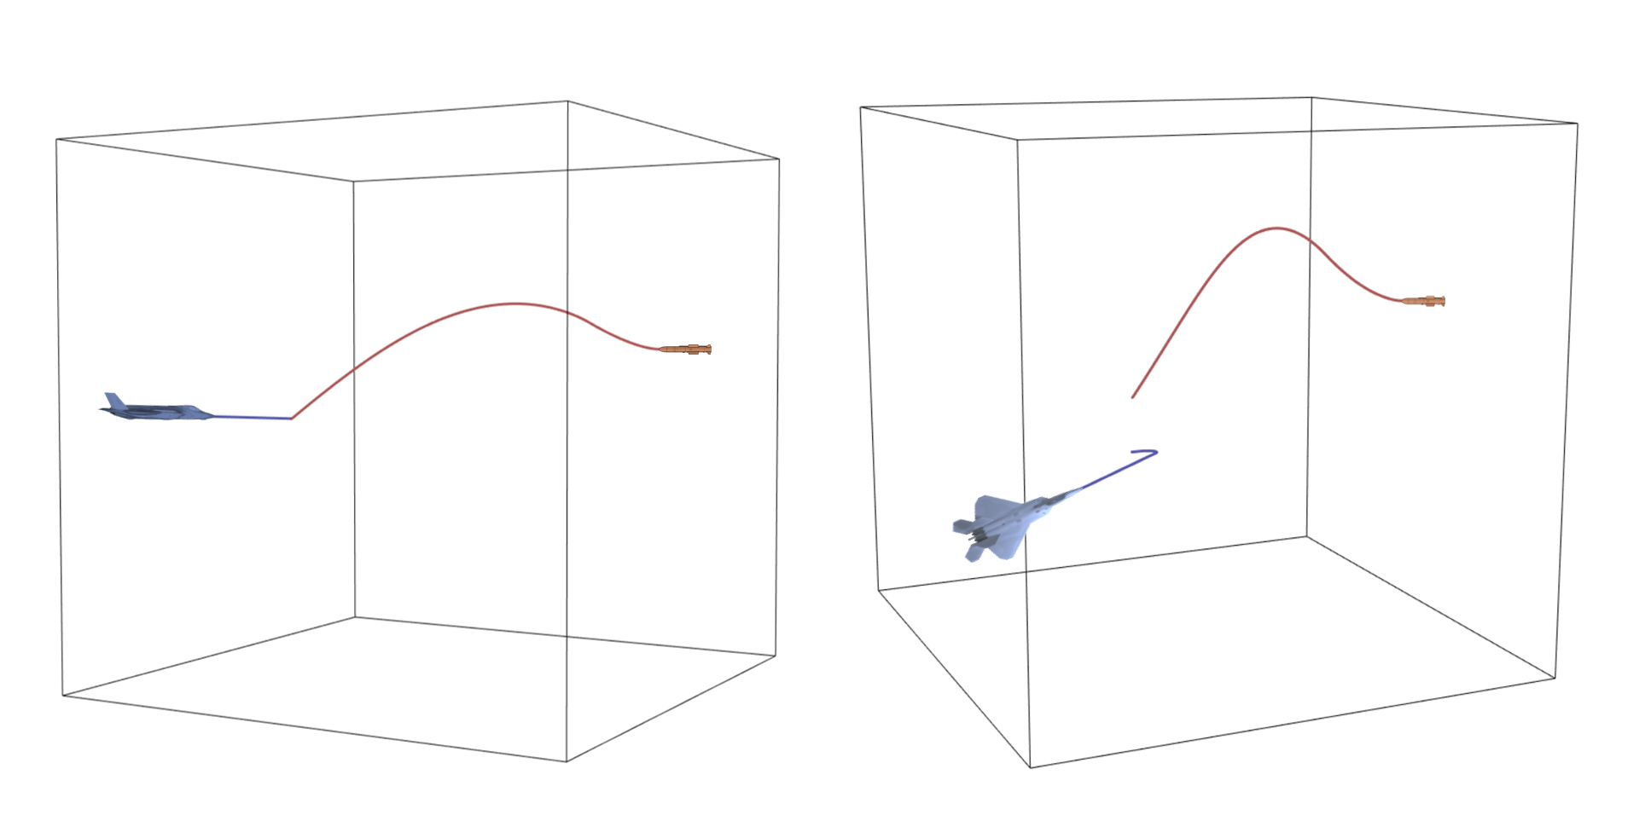
MISSILE MODEL
5 DOF
FOX 3
Perfect proportional navigation
Loft maneuver
Notes:
The missile model is a simplified model with 5 degrees of freedom (5DOF) of a Fox 3 missile-based on. Fox is a code that refers to the guidance of a missile and type 3 stands for an active radar-guided missile which contains a seeker of its own that can track the target autonomously after reaching its activation distance. Still, with regards to its guidance, the missile performs perfect proportional navigation concerning its target, maneuvering to exactly comply with its guidance law, as well as a loft maneuver that can be defined as a maneuver with an aggressive climb right after the missile’s launch.

Slide 7
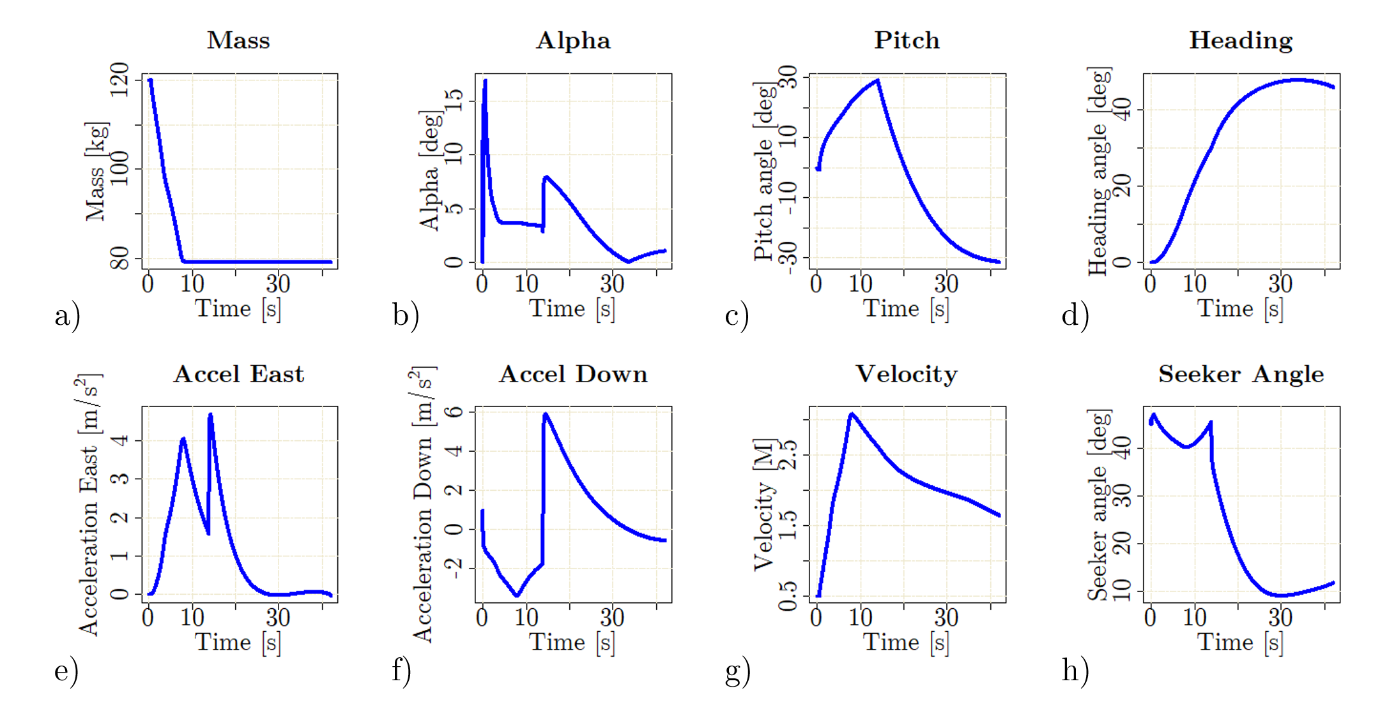
MISSILE MODEL
Notes:
We can analyse these eight metrics of the missile model.
The most straightforward metric is the mass (a). Since the missile operates with a boost-sustain motor its mass decays almost linearly during its burn phase.
Due to the loft maneuver, angle of attack values (alpha) vary very aggressively at the beginning of the flight, which can also be observed on the pitch angle chart.
Concerning heading, there are some maneuvers to respond to the high-performance evasion that the target employs.
Accelerations in both axis -- East (e) and North (f) in the NED coordinate system -- are also very abrupt due to the loft maneuver and the target response, respectively.
The velocity steadily increases during burn time and decays on the sustain phase.
Finally, the seeker angle accounts for the proportional navigation, being defined as the deviation of the shooter’s longitudinal axis from the off-boresight angle.

Slide 8
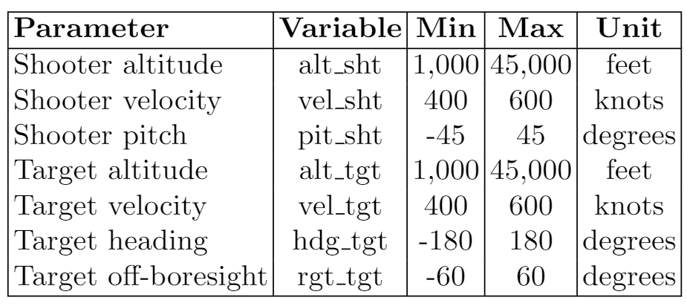
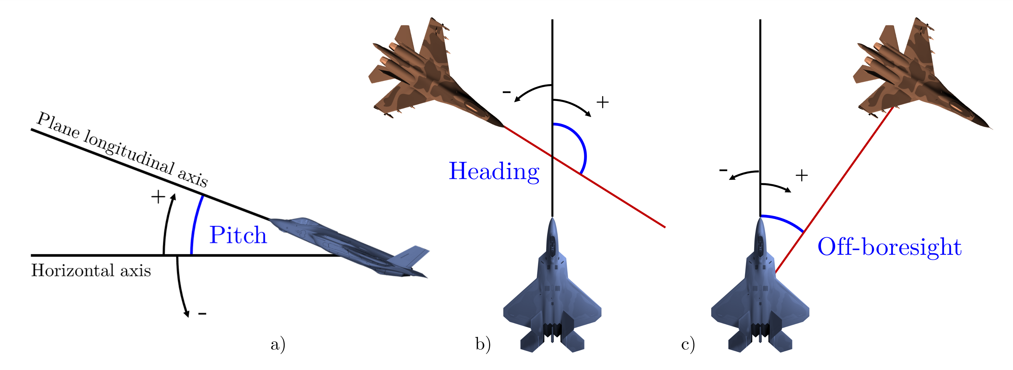
EXPERIMENTAL DESIGN
Notes:
The parameters used as inputs to our missile model are very similar to the ones presented in Birkmire’s work, which makes it easier to compare our results with the ones obtained by it. However, instead of using an implementation in MATLAB Simulink, our model was implemented entirely on R language which has many prepackaged programs that help to solve analytical problems, prioritizing the simplicity of understanding and the parametrization.
These parameters are selected based on operational experience and the missile model possibilities. The shooter's velocity and altitude are directly related to the energy that will be available to the missile. In particular, the launch altitude also influences the drag to which the missile will be subjected during flight, which is also true concerning the target altitude on the missile final approach. Target's velocity can either help or hinder the missile's effectiveness, depending on its heading. However, heading alone cannot provide a full account with regards to positioning, since this is dependent on the off-boresight angle to determine whether the target aircraft is getting closer to the shooter and, therefore, to the missile itself. At last, the shooter's pitch angle at the moment of launch may help the initial maneuvering of the missile, that is, its loft maneuver

Slide 9
SIMULATIONS SAMPLING
Latin Hypercube Sampling
50,000 construtive simulations
2 Intel Xeon Silver 4210R CPUs
2.40GHz
128 GB RAM
7 hours
Notes:
Instead of a full factorial experiment as Birkimire´s work presented, we tried to reduce the number of simulation runs by means of a more sophisticated design.
After creating the input batch files, we employ the Latin Hypercube Sampling with the variable’s limits presented to generate 50,000 simulations by using 2 Intel Xeon Silver 4210R CPUs with 2.40GHz and 128 GB of RAM. It took approximately 7 hours to execute all the simulations, which generated an output file containing the maximum range of the missile for the respective input conditions.

Slide 10
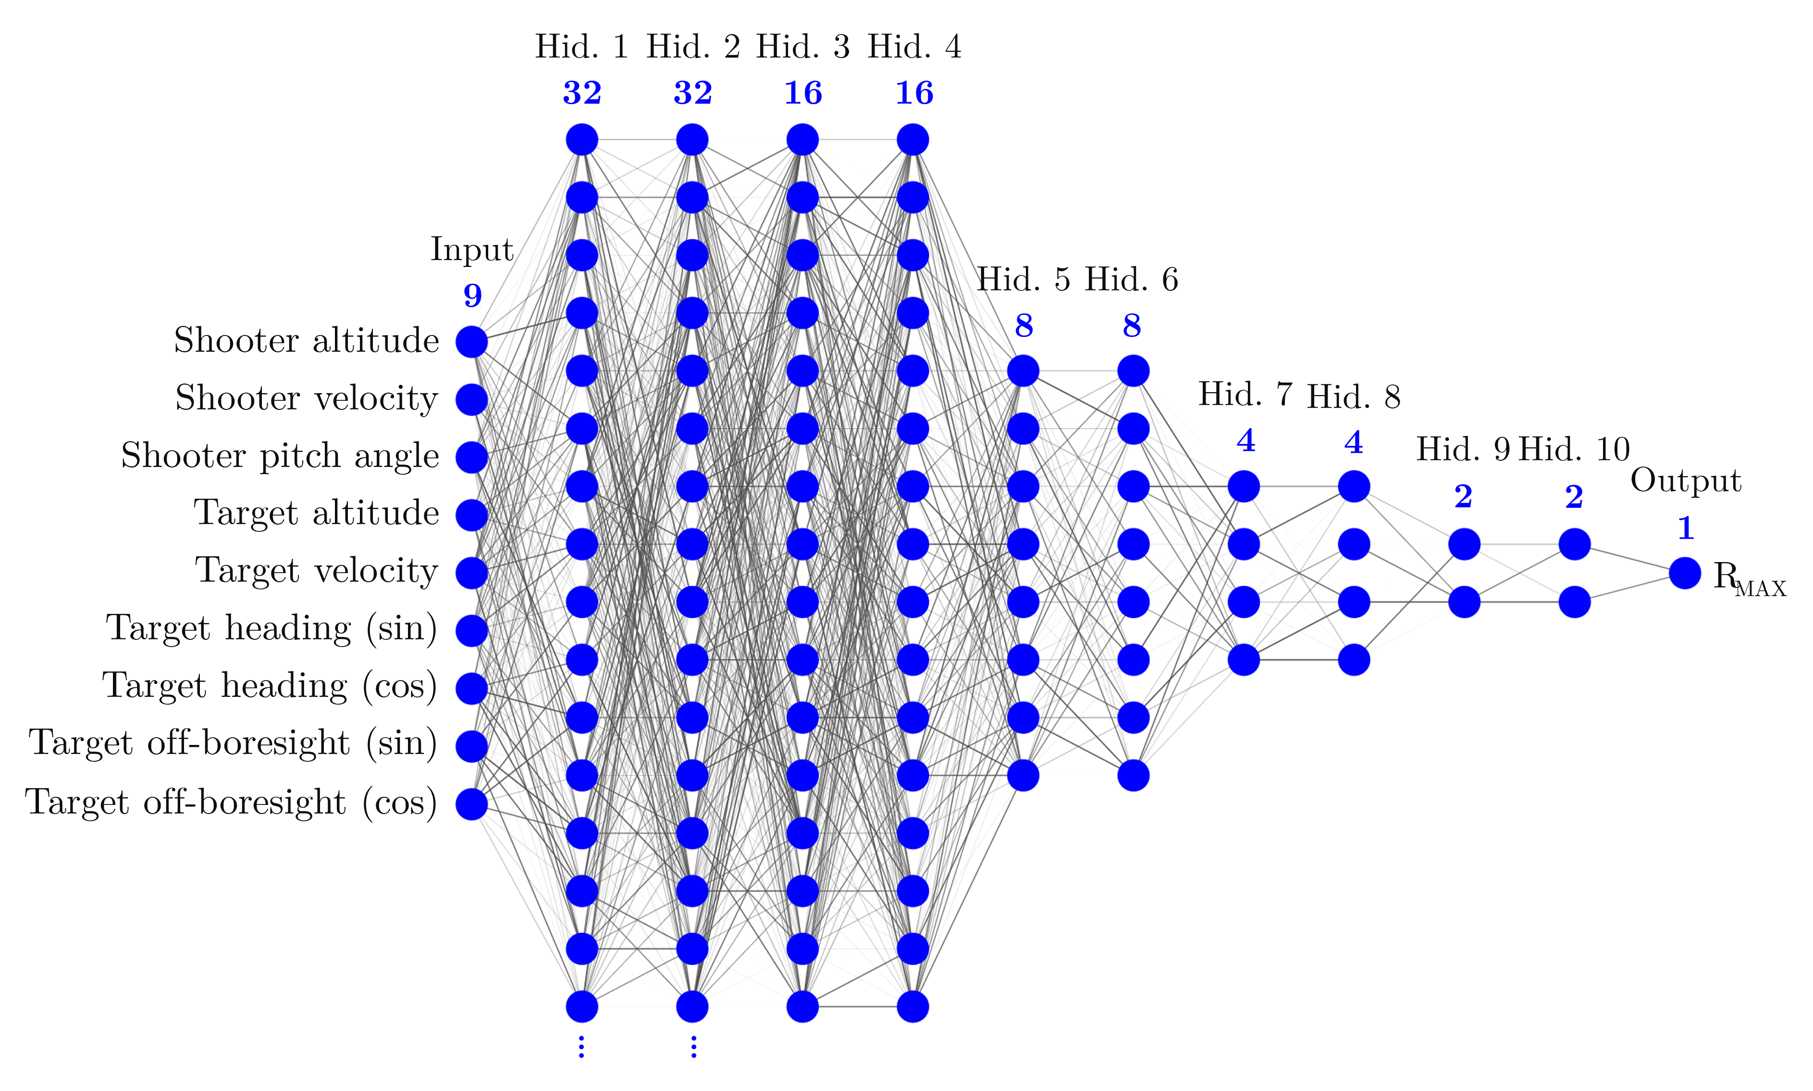
DEEP NEURAL NETWORK
Notes:
After collecting all data from the simulations, we need to build our supervised learning model based on a Deep Neural Network.
Before performing the training of the DNN, some feature engineering techniques were employed. The angles related to aircraft heading and off-boresight were encoded into their sine and cosine counterparts, slightly increasing our model performance.
Also, data scaling was performed to equally distribute the importance of each input in the DNN learning process.
We employ a train-validate-test split, allocating 80\% for training and validation using a 5-fold cross-validation technique, and 20\% for testing.
The DNN model was formed by 12 layers of nodes and the all nodes have a rectified linear activation function. The architecture is represented in this figure.
In addition, the Adam optimizer was employed, since it is an extremely popular training algorithm.
We tried to minimize the Mean Squared Error loss using a early stopping method with a patience of 20 epochs.
As the model being analyzed deals with a regression problem, the evaluation of the model will be carried out observing the following metrics: Mean Absolute Error (MAE), Mean Squared Error (MSE), Root Mean Squared Error (RMSE), and coefficient of determination.

Slide 11
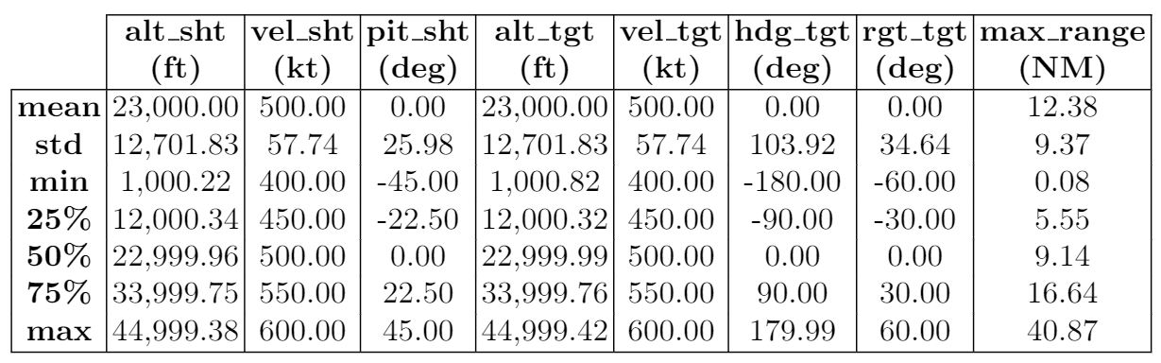
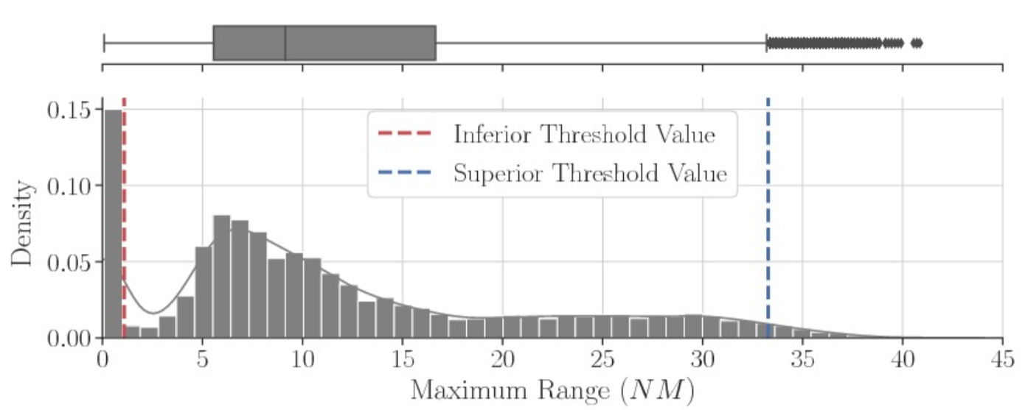
DATA ANALYSIS
Notes:
An Exploratory Data Analysis (EDA) was performed to identify general behaviors of the output data. The methods employed in this analysis were: histogram, boxplots, correlation, and descriptive statistics.
The model's output variable presents great variability with an average of 12.38 NM and a standard deviation (std) of 9.37 NM.
Notice that the mean and median are varying by 3.24 NM, which indicates a considerable amount of outliers for this variable at the top of the distribution.
These outliers will be eliminated from a superior threshold value (33.28 NM), which is not the maximum value (max), but is rather the largest value of the sampling excluding outliers, based on the interquartile range ($75\% - 25\%$).
Observing the minimum (min), values of the order of 0.08 NM can be found, which shows that in the dataset there are values in the target variable (\texttt{max\_range}) that are smaller than the minimum activation distance of the missile modeled. For this case, this distance is considered to be 1.08 NM, which is the inferior threshold.

Slide 12
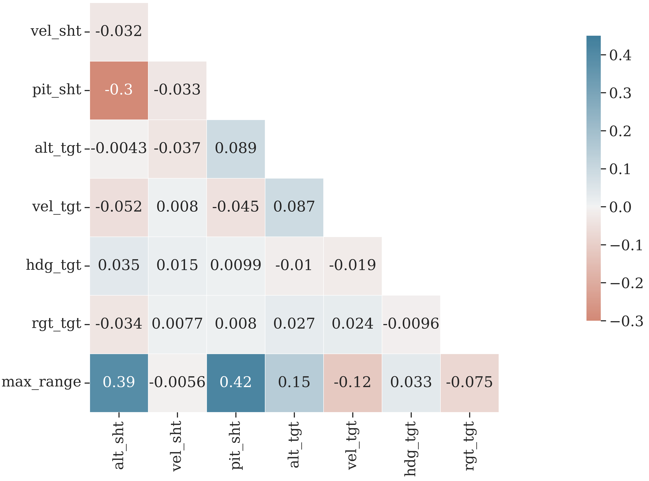
CORRELATION
Notes:
Pearson's correlation analysis of the variables can be seen in this correlation matrix.
Notice that none of the model's features has a strong correlation with each other, with the largest absolute value being only 0.30 between shooter's altitude and pitch. The performance of the algorithm may deteriorate if two or more variables are tightly related, called multicollinearity. We may also be interested in the correlation between input variables with the output variable max_range to provide insight into which variables may or may not be relevant as input for developing a model. Only the variables shooter's altitude and pitch have a slight correlation with the target variable.

Slide 13
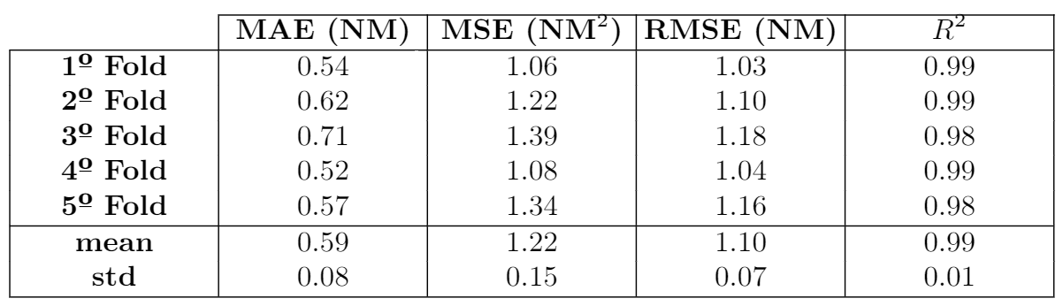
MODEL RESULTS
Notes:
A 5-fold cross-validation was conducted to estimate the skill of a machine learning model on unseen data and will help to better understand our data, giving much more information about our algorithm performance. The low variance found between the folds of this sample demonstrates the consistency of the model.
The means of all 5-fold metrics used to evaluate the best model at the end of the training process after performing the cross-validation were very satisfactory. with a coefficient of determination above 99%, which shows a very consistent model. In addition, note that the Mean Absolute Error was around 0.59 NM, which can be considered a very low value, considering that the values of the target variable have a mean of 13.13 NM with a standard deviation 8.58 NM. If we consider the RMSE, which penalizes the outliers' effects, the observed value is around 1.10 NM.

Slide 14
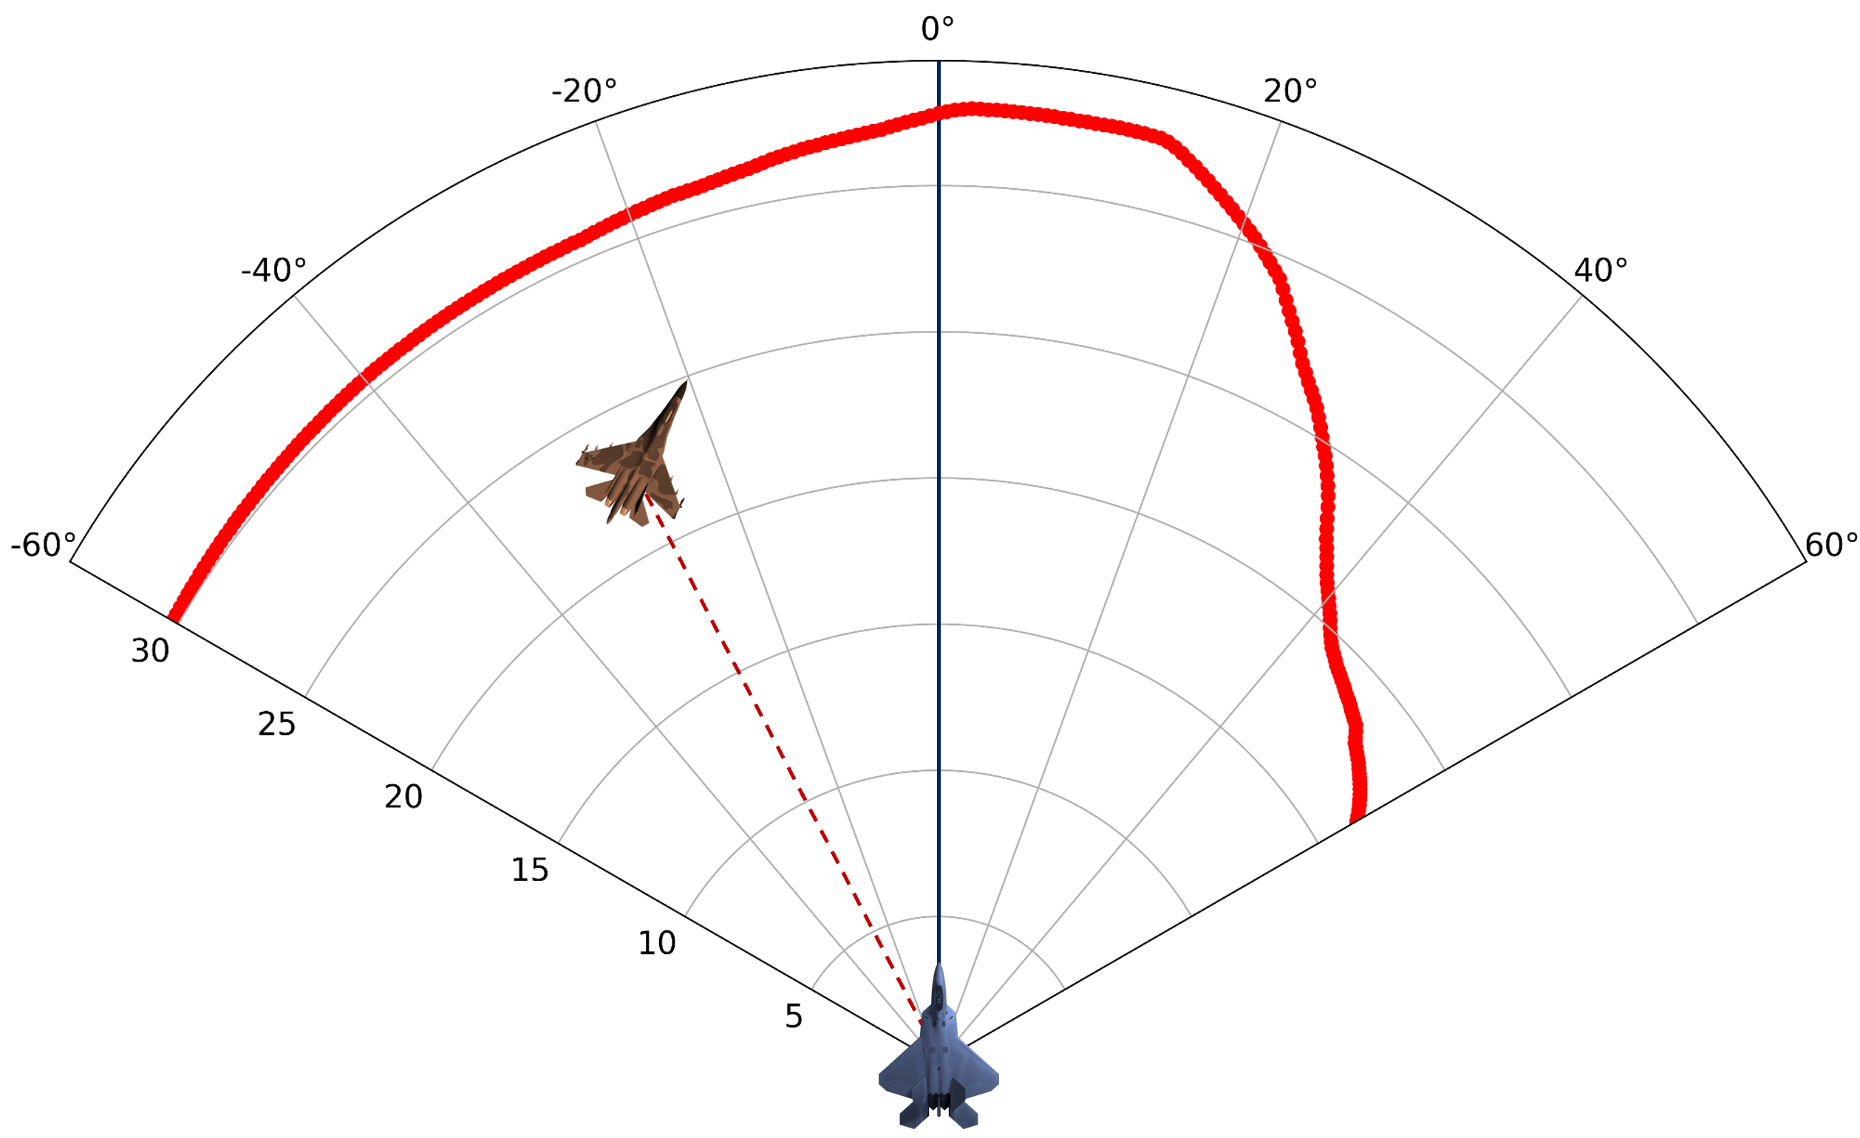
MODEL REPRESENTATION
Notes:
We estimated the WEZ Maximum Launch Range from the trained model using one of the samples from the test group. The target's position was varied by changing the off-boresight values from -60 degrees to 60 degrees with steps 0.5 degrees. We create Multi-Function Display representation with a focus on the WEZ indication which shows the missile's maximum range quite consistent, with a continuous aspect throughout the variations of off-boresight angles.
Thus, we conclude that employing a different approach, unlike other research, with the incorporation of the off-boresight angle between the reference and the target aircraft as a feature in the model does not affect the performance of the WEZ estimation since the supervised learning model used can be able to generalize well the results obtained in the training dataset to the test dataset.

Slide 15
CONCLUSIONS
No discretizing concerning off-boresight angle
50,000 vs 222,000,000
DNN vs Several ANNs with one hidden layer
5-fold cross validation
Feature engineering: sine and cosine
Notes:
Therefore, the main improvements advocated by us with respect to Birkmire’s work is that, instead of discretizing the WEZ calculation concerning the off-boresight angle between shooter and target, creating, therefore, several ANNs, we approached the problem considering the whole space defined by the shooter's radar, with only one DNN being able to predict the values of WEZ.
In addition, the number of simulation runs was much lower (50,000 runs, as opposed to 222 million in Birkmire´s work), which was achieved by a more carefully tailored experimental design.
In addition, in this work, a DNN with an MLP architecture was used, and brought better results than an ANN with only one hidden layer, as done in our benchmarking, comparing the coefficient of determination of both approaches applied to their respective datasets.
In addition, different configurations of training and test groups were used in the dataset using the k-fold cross-validation.
The use of feature engineering techniques, with the creation of other model input variables, such as the use of sine and cosine for the variables that represent heading and off-boresight angles, also contributed to greater adequacy of the model to the dataset collected from the simulations.

Slide 16
FUTURE WORK
Improvement in the DNN architecture
Results compared with other supervised learning techniques
More advanced missile models
Notes:
Future work should investigate how possible improvements in the architecture used for the DNN can bring better results and be more efficient, with a lower computational cost in the training process.
In addition, the results found in this work can be compared with the use of other supervised machine learning techniques. These comparisons will help to determine the most appropriate methodology for calculating WEZ. In addition, in future work, it is possible to carry out calculations not only of the maximum range but also the distances related to the NEZ or even intermediate distances that could provide pilots with more assertive information about the probabilities of a missile reaching its target.
Also, more advanced simulation models of the missile may be used in the future to provide better reliability to the presented results.

Slide 17
ACKNOWLEDGMENTS
Finep (Reference nº 2824/20)
CNPq - National Research Council of Brazil (grant 303134/2-18-0)
Notes:
This work was supported by Finep (Reference nº 2824/20) and Prof. Takashi Yoneyama is partially funded by CNPq -- National Research Council of Brazil through the grant 304134/2-18-0.

